Slide 1

Automated IIITA Timetabling System
Group:-
Rahul Roy - IIT2023196
Lakvath Peer Singh - IIT2023197 Eshant - IIT2023198

Slide 2
Problem Statement
Core Problem: University timetabling is a complex matching problem classified as NP-hard.
This means finding a perfect solution is too slow for large schedules, so we use heuristic algorithms instead.
Mathematical Objective: Minimize cost function P(x) where H(x) = 0 (hard constraints) and S(x)
>= min (soft constraints).
Hard constraints are strict rules that must never be broken.
Soft constraints improve schedule quality but are not strictly required.

Slide 3
Literature Review
 | Method / | Key Idea | Advantages | Limitations | Reference
 | Technique
 | Genetic Algorithm (GA) | Represents timetables as chromosomes and evolves them using crossover and mutation. | Explores a large search space and improves solutions over generations. | Crossover frequently breaks structures, requiring complex repair tools. | Burke et al.
 | Evolution Strategy (1+1-ES) | Maintains a single solution and iterates using mutation only. | Lower cost (evaluates one candidate); avoids destructive crossover. | Requires extremely careful design of mutation operators. | Srivastava et al.
 | Improved ES with Preprocessing | Combines ES with preprocessing techniques and structured mutation. | Faster convergence speed and produces much higher-quality schedules. | Implementation complexity slightly higher. | Srivastava et al.

Slide 4
Formulation of Hard Constraints
The solver evaluates fitness using a scalarized penalty function:
P(S) = Σ (W * C ) + Σ (W * C )
hard hard soft soft
Hard Constraints (W_{hard}= 1000):
TIME BOUNDARY: A session must absolutely not exceed the final slot of the day. endSlot = startSlot + duration - 1 must be ≤ 8 (18:30).
BREAK / LUNCH CROSSING: A continuous multi-slot session (like a 2-hour lab) must NOT span across a structural break.
- Slot 2 → Slot 3 (10:50 – 11:00 break) • Slot 4 → Slot 5 (13:00 – 14:30 lunch).
ROOM NON-OVERLAP: A physical room can host at most ONE session at any (day, slot). Multiple sessions placed in the same room simultaneously cause clashes.

Slide 5
Formulation of Hard Constraints
The solver evaluates fitness using a scalarized penalty function:
P(S) = Σ (W * C ) + Σ (W * C )
hard hard soft soft
Hard Constraints (W_{hard}= 1000):
PROFESSOR NON-OVERLAP: A distinct professor can teach at most ONE session at any (day, slot).
STUDENT GROUP (SECTION) NON-OVERLAP: A specific section of students can attend at most ONE session at any given (day, slot).
Exception: Sessions from the SAME basket (Synced or Free) are allowed to overlap because students pick only one subject per basket.
HOME ROOM FOR LECTURES/TUTORIALS : Core lectures and tutorials MUST occur in the designated 'Home Room'. (Practicals and Electives are exempt).

Slide 6
Formulation of Hard Constraints
The solver evaluates fitness using a scalarized penalty function:
P(S) = Σ (W * C ) + Σ (W * C )
hard hard soft soft
Hard Constraints (W_{hard}= 1000):
ELECTIVE RULES & SYNCHRONIZATION Exception:
Rule A (Sync): All sessions in a "Synced Basket" (e.g., HSMC,MDM) MUST be scheduled at the exact same (day, slot).
Rule B (Free): Electives in "Free Baskets" can be scheduled independently.
Rule C (Anti-Clash): Sessions from DIFFERENT baskets must never overlap, ensuring students can pick one from each without conflict.
LAB ROOM FOR PRACTICALS : Practical sessions MUST be assigned to rooms with room_type 'Lab'.

Slide 7
Formulation of Hard Constraints
The solver evaluates fitness using a scalarized penalty function:
P(S) = Σ (W * C ) + Σ (W * C )
hard hard soft soft
Hard Constraints (W_{hard}= 1000):
WMC VS SECTION : If a WMC session is scheduled, no individual sub-section belonging to that batch can have a separate core class at that time.
2+1 LECTURE FORMAT : For subjects with lectures >= 2, the lecture hours are split into:
• Exactly ONE 2-hour double-lecture block (lecturePairIndex = 0) • All remaining hours as individual 1-hour sessions (lecturePairIndex = -1)

Slide 8
Soft Constraints
Soft Constraints :
STUDENT GAP PENALTY (COMPRESSION)(W=1.0): Minimizes empty "free" slots between a student groups first and last class of the day to compress their schedule.
ROOM UTILIZATION PENALTY (W=0.8) : Encourages efficient use of space. Penalties apply if room fill ratio is < 60% (under-util) or > 120% (over-util).
PROFESSOR SAME-HALF PENALTY (W=5.0) : Encourages compact faculty schedules. A penalty is added if a professor teaches in both Morning (1-4) and Afternoon (5-8) halves.

Slide 9
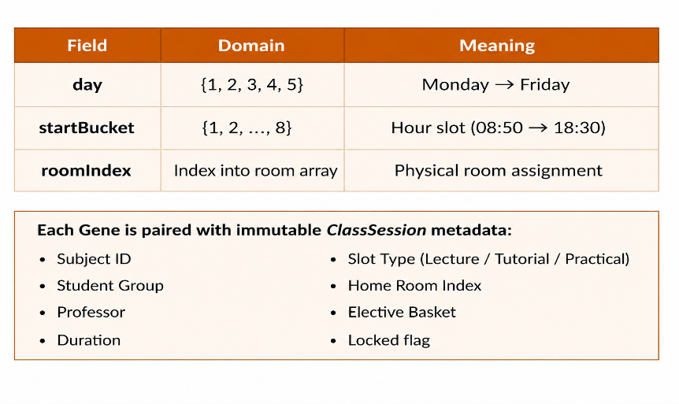
Problem Representation(Chromosome)
The solver models a complete timetable as a Solution — an ordered array of Gene objects.
Each Gene encodes one scheduling decision:
Each Gene is paired with immutable ClassSession metadata:
Subject ID, Student Group, Professor
Duration, Slot Type (Lecture / Tutorial / Practical)
Home Room Index, Elective Basket, Locked flag

Slide 10
The (1+1)-ES Algorithm—Mutation
In each generation, the solver selects 3–8% of mutable sessions and applies one mutation operator governed by the variance parameter σ.
Mutators Used:
1. Mutate Day: Randomly reassigns the session to a new day ∈ {1, ..., 5}.
2. Mutate Time (Gaussian): Shifts the starting slot by Δ = ⌊𝒩(0, σ²)⌉ while ensuring valid timetable bounds. Breaks are adjusted using a precomputed valid-slot list.
3. Mutate Room (Type-Sensitive):
Practicals → Random Lab Room
Electives → Random Lecture Room
Core Sessions → Fixed Home Room (No Mutation)
4. Relocate (Global Move): Randomly reassigns the entire (Day, Time, Room) configuration.

Slide 11
Selection & σ-Adaptation
5. Swap: Exchanges (Day, Time, Room) between sessions of equal duration.
Elitist Selection
The Child replaces the Parent only if f(S_child) ≤ f(S_parent).
This greedy elitism protects hard constraints; the solver never accepts a worse solution.
σ-Adaptation (Rechenberg's 1/5th Rule)
Checked every W = 50 generations. Let p_s = success rate (rate of no of times child won over parent):
σ ← {σ × 1.22 if pₛ > 20% (Explore More) σ × 0.82 if pₛ < 20% (Fine-Tune) σ otherwise }

Slide 12
Stagnation Recovery
Intuition:
Too many successes → σ is too small → increase it to explore wider
Too few successes → σ is too large → decrease it to refine locally
Stagnation Recovery:
If best fitness doesn't improve for 15,000+ consecutive generations (stuck at local optimum):
Current solution is discarded
A completely new random initial solution is generated
σ is reset to the initial value
The global best solution is kept safe in memory (elitist tracking)

Slide 13
Locked Sessions
Locked Sessions (Inter-Semester Awareness):
When generating for Semester 3, the solver loads published timetables from Semesters 1, 5, 7, etc.
These sessions are injected as immutable genes (isLocked = true)
They are never mutated but fully participate in constraint evaluation

Slide 14
System Design
System Design (Three-Tier Architecture):
Database (Supabase): Stores Professors, Rooms, Groups, and Subject L-T-P counts.
Frontend (React/TypeScript): An interface for HODs to map professors to subjects and sections.
Solver (Client-Side): A background engine in the browser that continuously improves the timetable.

Slide 15
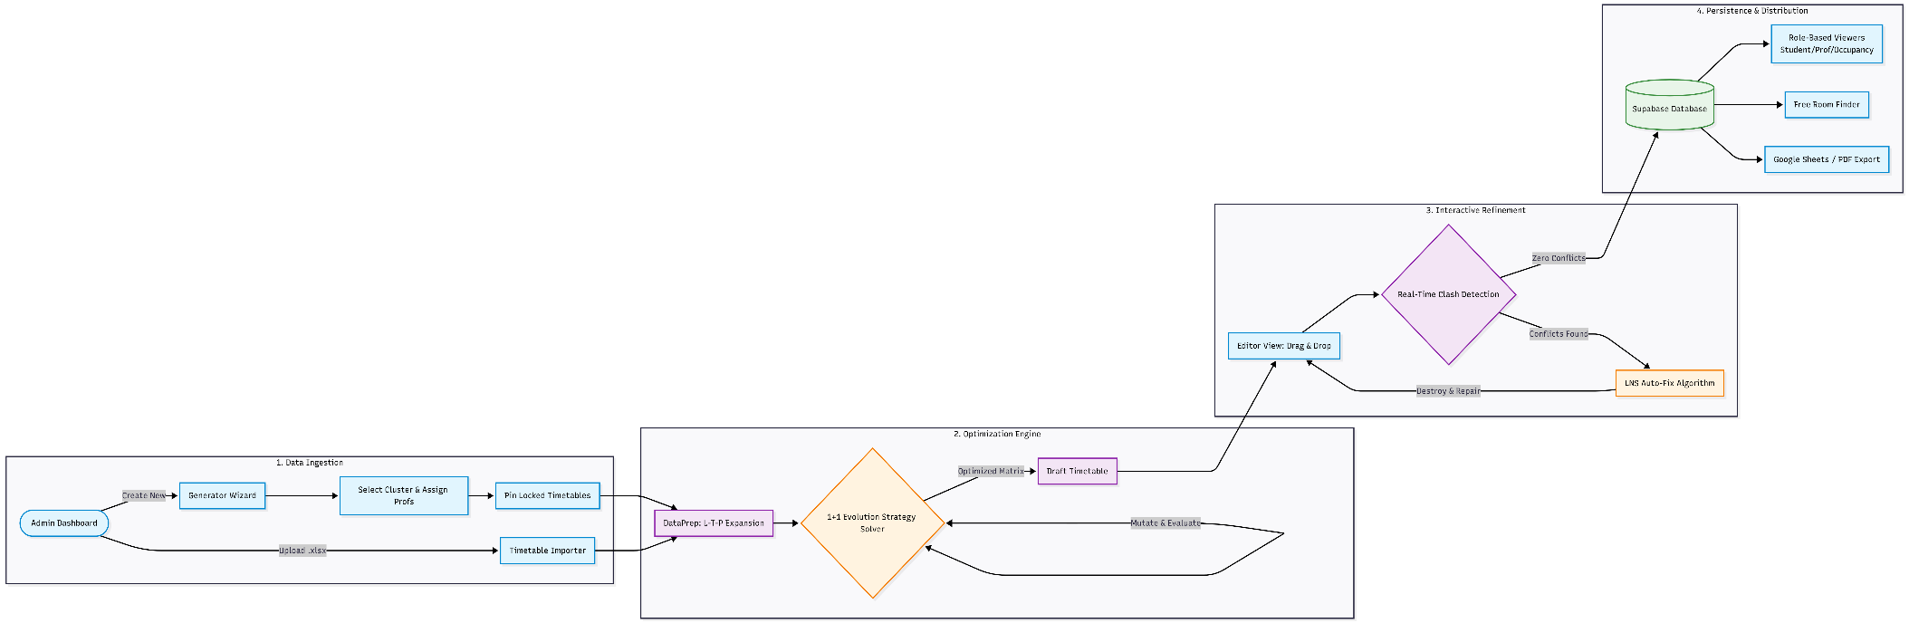
System Workflow

Slide 16
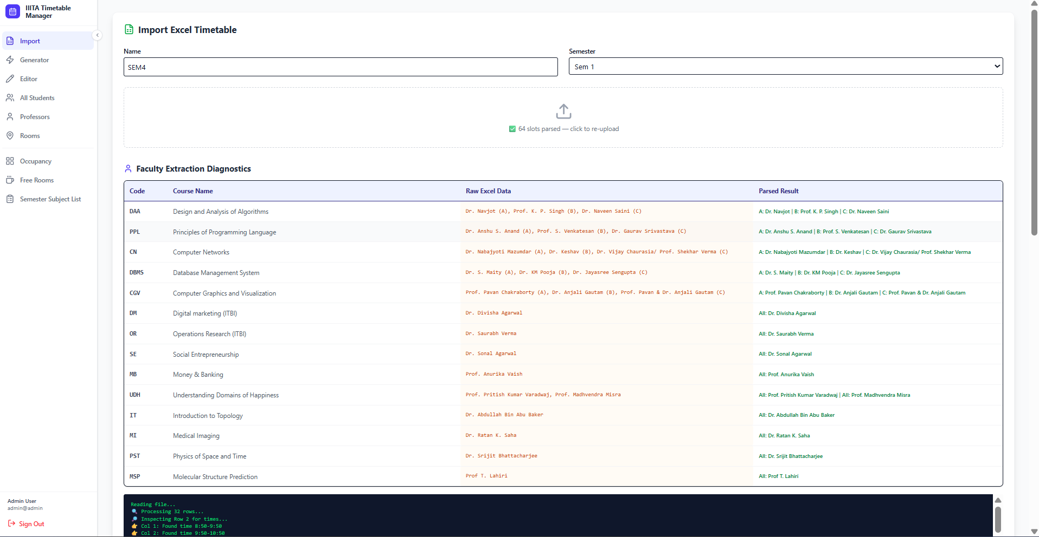
Data Input: The Timetable Importer
• Flexible Offline Timetable Entry: Timetables can be uploaded directly using Excel files without running the solver.
• Bulk Data Mapping: Automatically converts subject codes, professor names, and room IDs into database records.
• Immediate Synchronization: Uploaded timetables instantly appear across all system views.

Slide 17
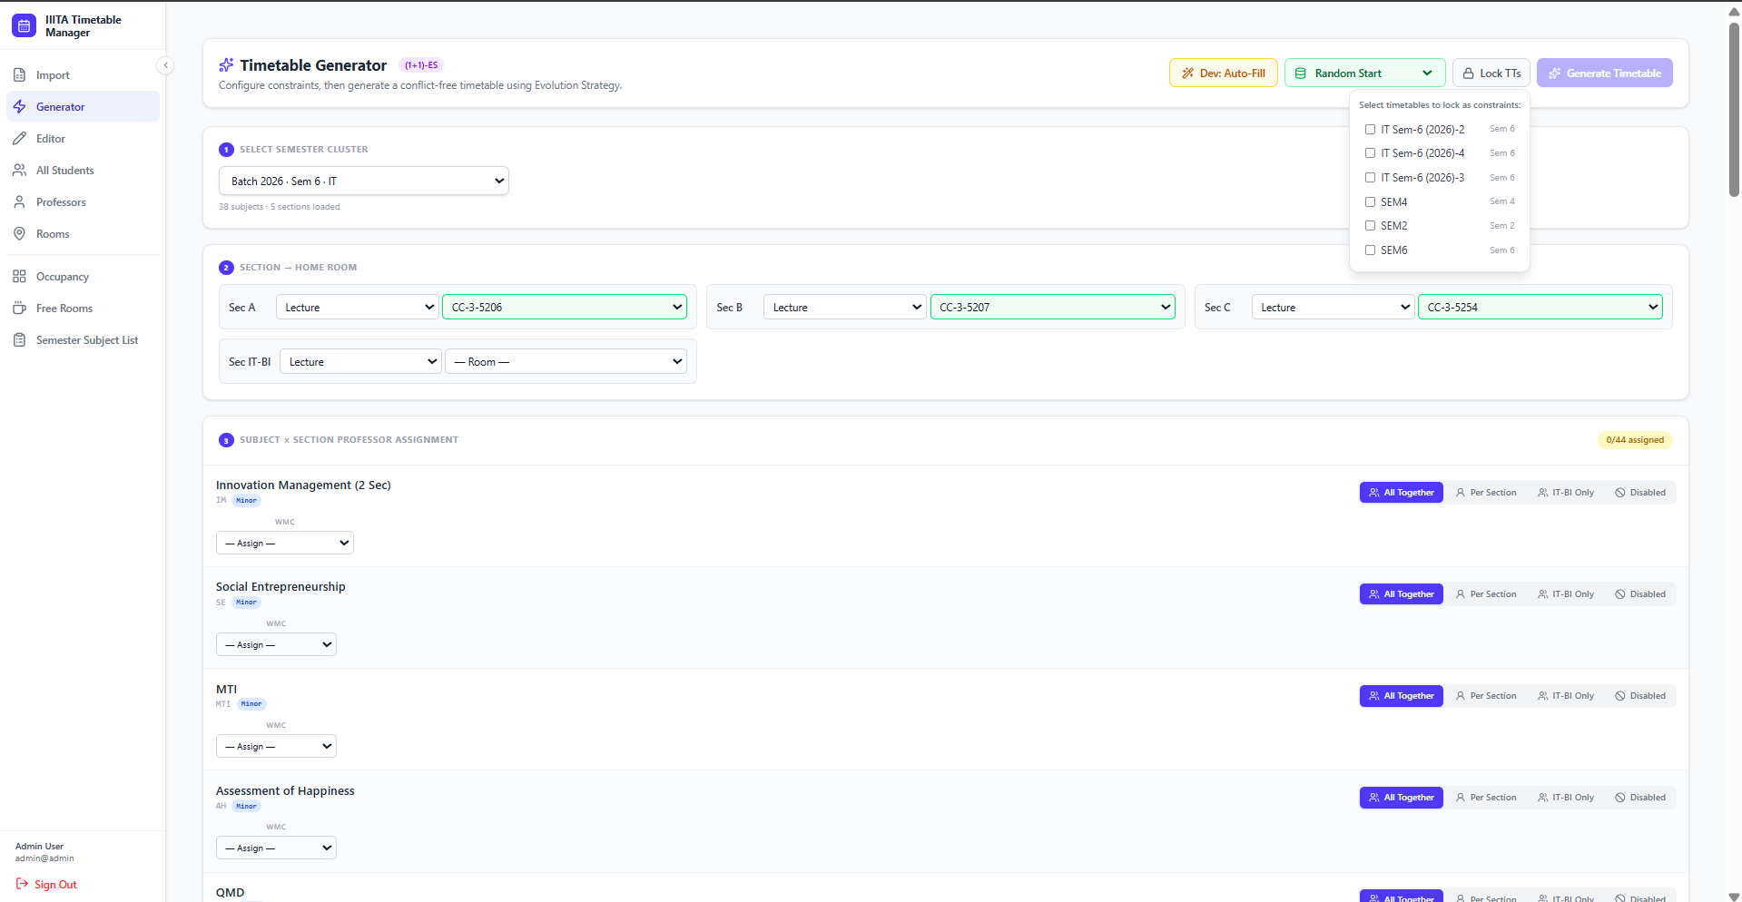
Automated Scheduling: The Generator
• Guided Configuration: Assists in assigning students, professors, and home rooms before timetable generation.
• Cross-Semester Locking: Prevents clashes by treating existing semester timetables as fixed constraints.
• Client-Side (1+1)-ES Solver: Generates optimized timetables directly in the browser with live fitness updates.

Slide 18
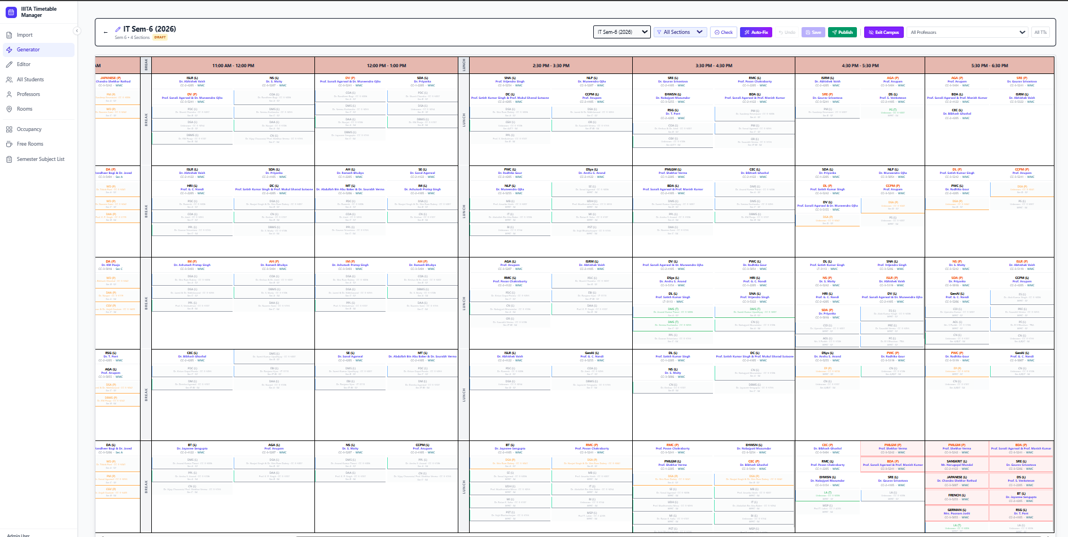
Human in Loop : The Interactive Editor
• Drag & Drop Matrix: A 5-day interactive calendar for easily adjusting timetable schedules.
• Real-Time Clash Detection: Instantly warns about room, teacher, or section conflicts after changes.
• LNS Automated Fix: Automatically repairs timetable clashes with a single click.
• Inline Editing: Quickly reassign teachers or rooms using hover-based edit options.

Slide 19
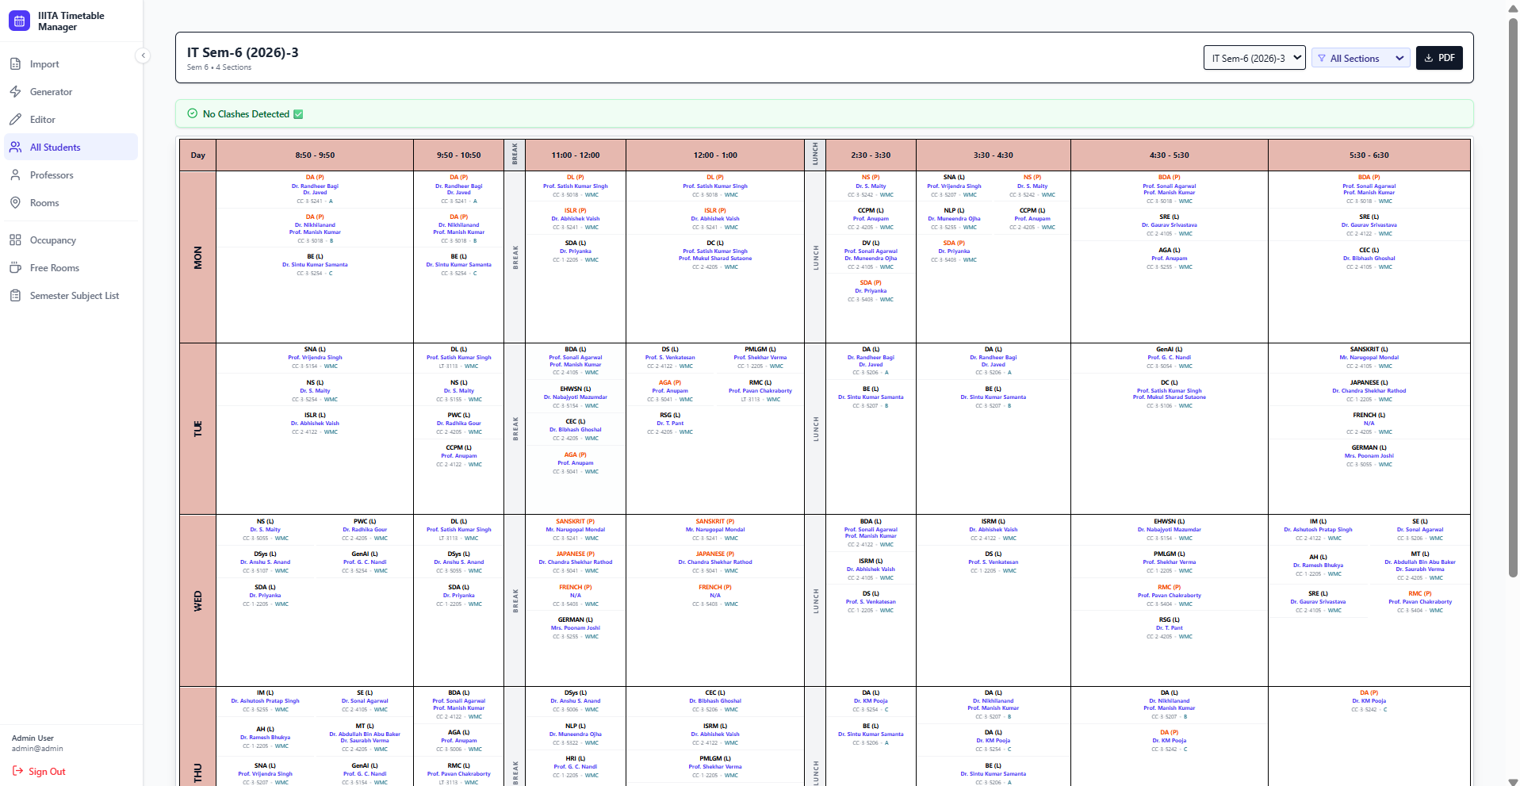
Student Dashboards: Students View
• Filtered Personalization: Lets users view schedules by selecting a specific semester and section.
• Intelligent Merge Algorithm: Combines core lectures and elective sessions into one timetable.
• Time Column Management: Hides unused time slots to improve readability and save space.

Slide 20
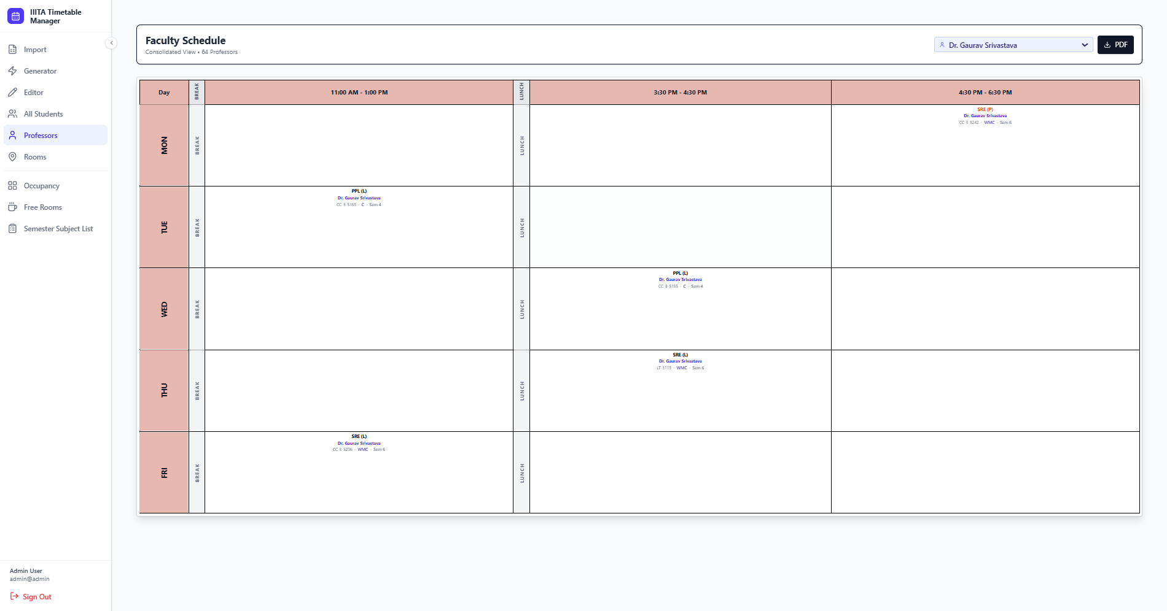
Faculty Dashboards: Professors View
Unified Timetable for Teachers: It enables teachers to search using their name or teacher’s ID to find out what classes they have scheduled at the institute overall.
No More Checking Multiple Timetables: No more hassle for professors since all the information is consolidated in one place.
Ready for Export: It works seamlessly with the 1-click PDF export feature.

Slide 21
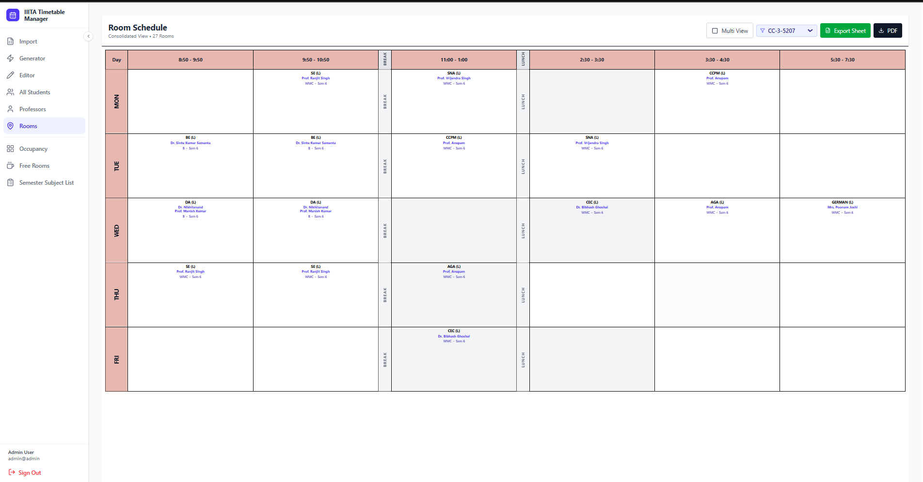
Facility Tracking: Individual Room View
• Room Schedule Lookup: Allows admins to view the timetable of any room in the university.
• Room Type Filtering: Quickly separates lecture rooms from lab rooms.
• Google Sheets API Export: Exports room timetables directly to the administrator’s Google Drive.

Slide 22
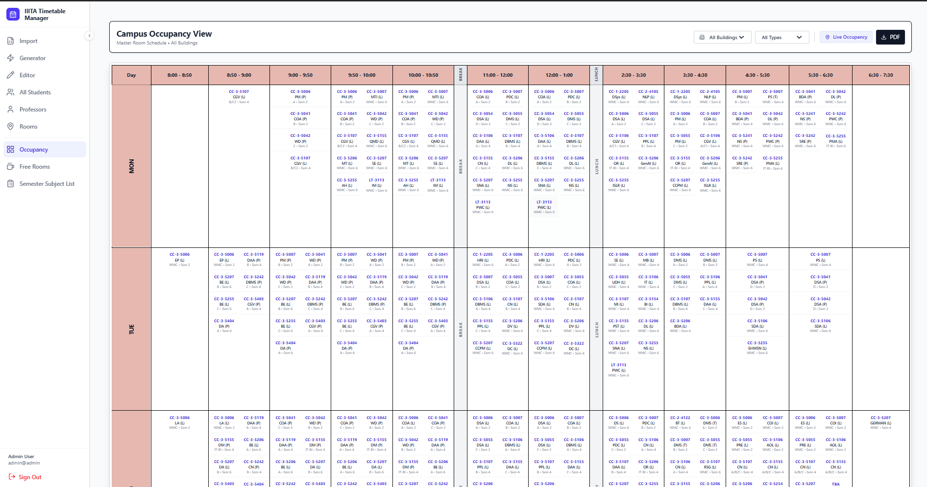
Campus Admin: Master Occupancy View
• Macro-Level Perspective: Displays room usage across the campus in a bird’s-eye view format.
• Filtering by Building Prefix: Shows only rooms from selected buildings such as CC-3.
• Usage Audit: Helps analyze room utilization for full-day planning and management.

Slide 23
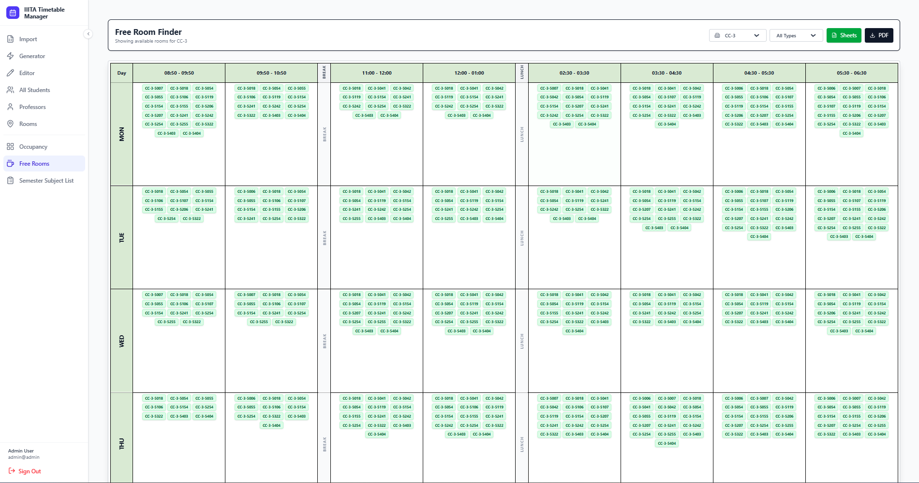
Availability: The Free Room Finder
Inverted Logic Algorithm: Calculates available rooms by deducting occupied slots from the total inventory in the entire campus.
Instant Availability Matrix: Shows all available rooms immediately for a particular day and slot.
Universal Application: Helps both students who require a place to study and staff members planning maintenance activities.

Slide 24
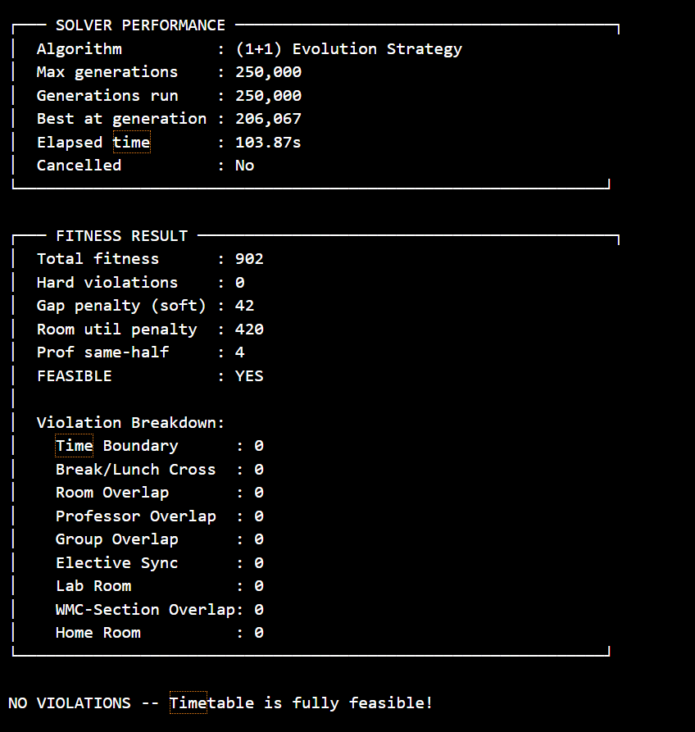
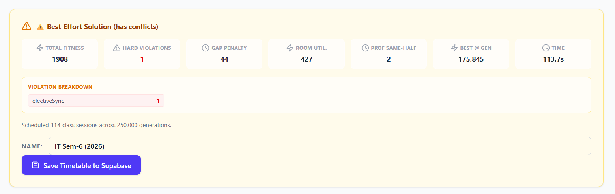
Results

Slide 25
Advantages
The Pivot to (1+1) Evolution Strategy
Data Simplification: Drastically simplified target representation by pre-chunking sessions upfront.
Memory Footprint: (1+1)-ES holds only one parent and one offspring, making it memory light for browser execution, unlike population-based Genetic Algorithms (GAs).
Local Minima Management: Implemented strict Rechenberg's 1/5th success rule to manage the local minima problem natively.
Adaptive Variance: Scales search intensity without relying on brittle cooling schedules, allowing the solver to maintain constraint integrity through strict elitism.

Slide 26
Conclusion
Final Result: The implementation successfully manages the L-T-P division and the (1+1)-ES loop.
Overcoming Obstacles: The system resolves hard conflicts in high-density scenarios where previous implementations failed.
Preserving Structure: It specifically maintains the integrity of synchronized elective blocks through elitist selection.
Ready Structure: The architecture serves as a functional, optimized solution for modern university timetabling needs.

Slide 27
THANK YOU!

Slide 28
Glossary - Rechenberg’s 1/5th Success Rule
Definition of the Method:
Adaptive rule in evolutionary algorithms for dynamic control of “step size” (mutation), requiring that the ideal number of successful mutations be precisely equal to 20% (1/5).
How Did We Apply It?
1. When the solver is too chaotic (excessively many failures). In this case, the solver is moving randomly, chaotically. In order to avoid such a situation, the mutation rate is decreased by the system.
2. When the solver is too stagnant (excessively many successes). This situation means that the algorithm is moving too slowly. The mutation rate is increased by the system.
Results:
Our (1+1)-ES solver can be considered as an intelligent “brain,” dynamically adjusting between the global search and local search every 50 generations. Consequently, fast convergence toward a zero-conflict schedule is achieved.

